Slide 1

Hotel Booking Demands

Slide 2


team
B V S L Saikrishna
Annu
Emmanuel
Akhil

Slide 3


Agenda
Introduction of Dataset
Data Exploration
Model Comparison
Final Model Analysis
Recommendations
Appendix
References

Slide 4


Introduction of dataset
Our data set explain the booking cancellations of a city hotel and a Resort hotel which are happened from the year 2015 to 2017.
There are a total of 119390 Rows and 32 Columns in this dataset.
There is no personal information included in the data set
Most of the columns in the dataset had 0 and 1 values which increases the complexity of analyzing the predict variables with target variable

Slide 5


Business Problem
In Portugal, a resort hotel at Algarve and a city hotel at Lisbon are one of the major source of income to the business owners from the customers who check-in at their hotels.
Problem:
When hotels experience booking cancellations from the customers multiple times, it results in lower occupancy of rooms at the hotel consequently increasing the losses incurred by the business owners.
Both the hotels are unable to find the affecting parameters of booking cancellations in order to increase the occupancy the hotel.

Slide 6
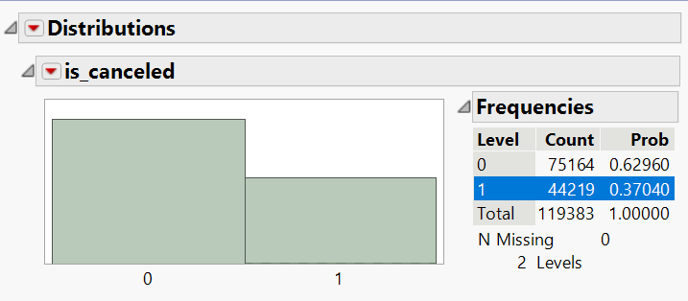
Data Preprocessing:
Target Variable – is_canceled (Categorical Variable type)
It explains about the status of the booking whether its cancelled or not.
The column contains binary values where ‘0’ represents booking is not cancelled and ‘1’ represents that the booking is cancelled.

Slide 7
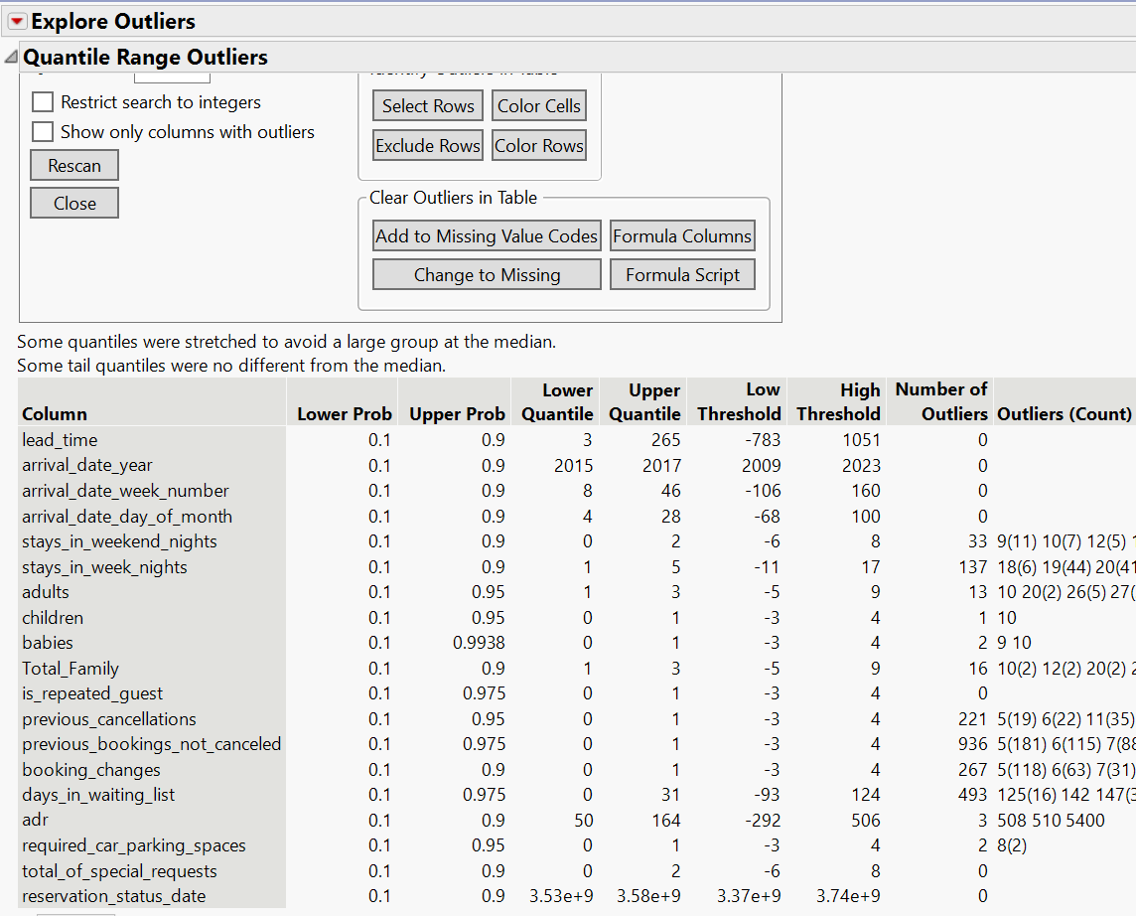
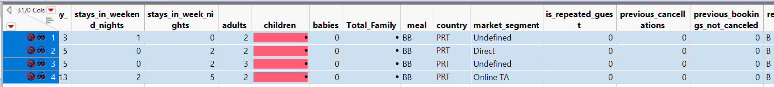
Data Exploration:
Out of 32 columns, we have excluded 18 insignificant columns with respect to the target variable
Outliers - There are quite less variables that have outliers as, most of the attributes have binary values (0,1), hence low number of valid outliers.
Missing values – There are a total of 4 missing rows, which are hidden for having no values for the column ‘children’.

Slide 8
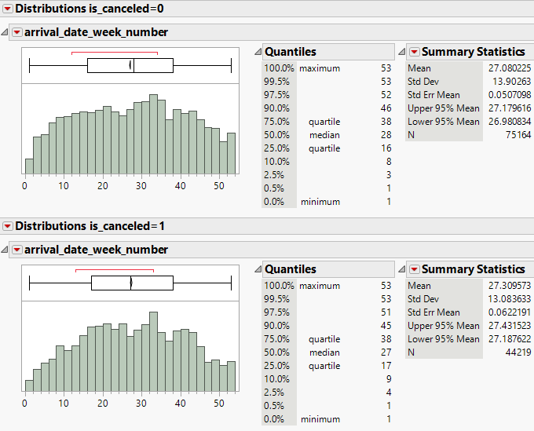
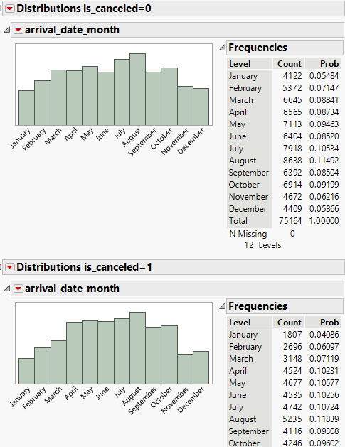
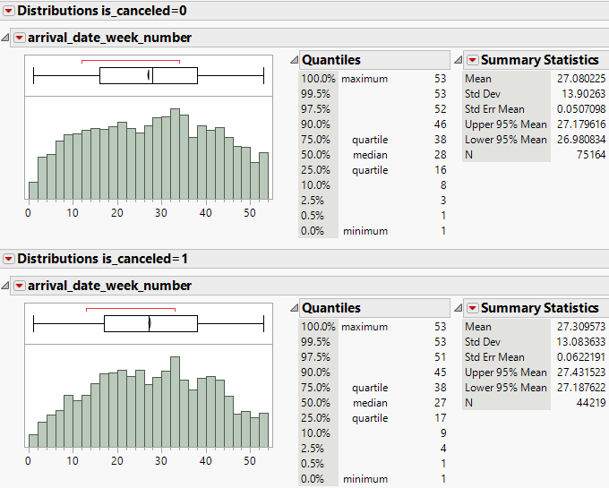
Data Exploration(Contd.):
Excluded Columns
It gives information about the date, week, month of the arrival and stays the booking has and is showing high correlation between the cancelled (1) and non cancelled (0) bookings. So we decide to exclude this variable.
arrival_date_year
arrival_date_month
arrival_date_day_of_month,
arrival_date_week_number

Slide 9
Excluded columns:
‘stays_in_weekend_nights’ and ‘stays_in_week_nights’ : The distribution depicts the nights stayed at the hotel during the weekdays or weekend. And its distribution shows high correlation which is redundant, hence we exclude this column.
‘adults’, ‘children’, ‘babies’ : It gives us the information about the adults and kids staying on the confirmed booking, which shows similar mean and distribution for '0' and '1' booking status. So, we exclude these column.
‘required_car_parking_spaces’ : The cancellation ‘1’ has null values, means there is no relation of target variable w.r.t. parking space. And cancellation ‘0’ has maximum probability, so we can say 100% that there is no dependency of the car parking availability on our target variable.

Slide 10
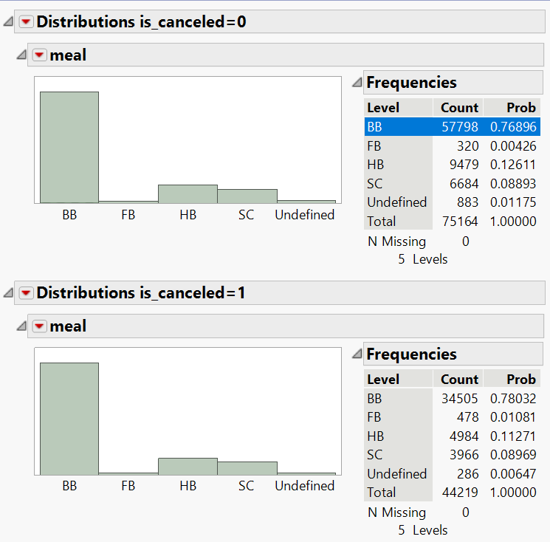
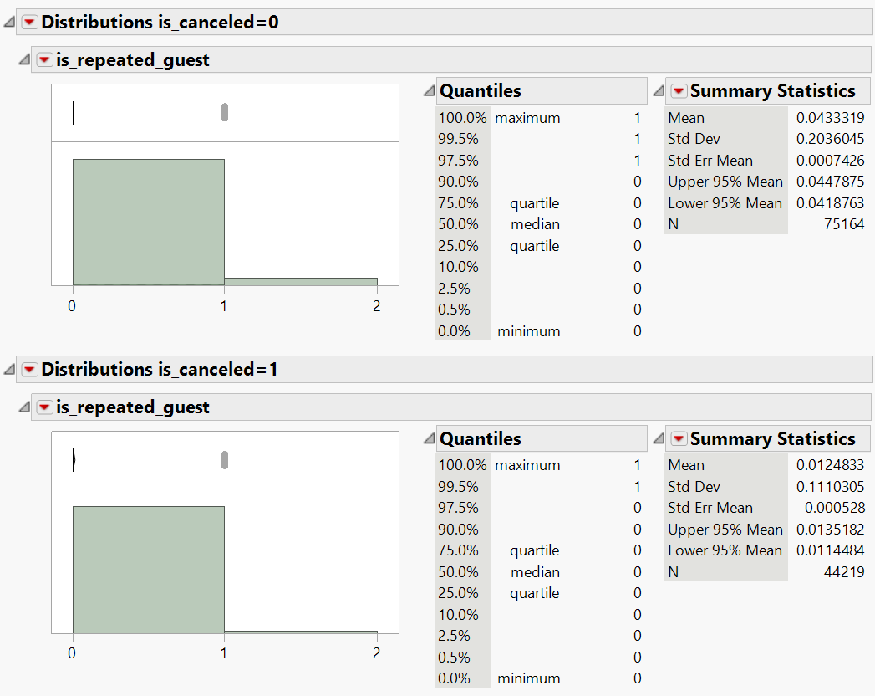
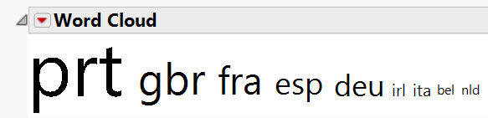
Excluded columns:
‘meal’ : The distribution depicts the various meal plans of customers who cancel their bookings and those who don’t . And they show high correlation which is redundant information, hence we exclude this column.
‘country’ : It gives us the information about the country of origin of the customer, which shows similar mean and distribution for '0' and '1' booking status. So, we exclude this column.
‘is_repeated_guest’ : The cancellation ‘1’ has null values, means there is no relation of target variable w.r.t. parking space. And cancellation ‘0’ has maximum probability, so we can say 100% that there is no dependency of the car parking availability on our target variable.

Slide 11
Final Predictor Attributes:
Is_canceled
Direct (Dummy column)
Groups (Dummy column)
Offline TA/TO (Dummy column)
is_repeated_guest
A (Dummy column)
D (Dummy column)
booking_changes
No Deposit
Non Refund
Transient
Transient-Party

Slide 12
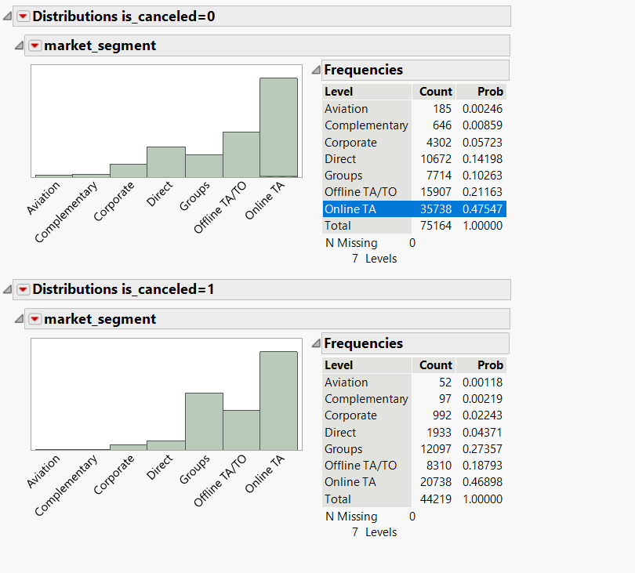
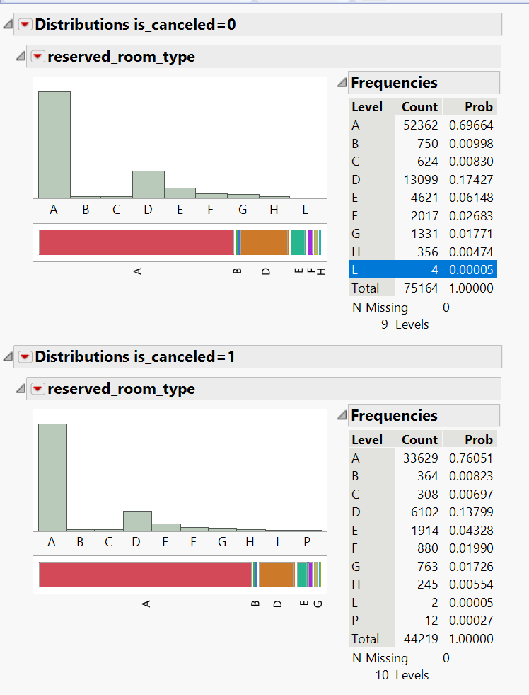
Findings/ Trends from Data Exploration
From this, we understand that Aviation and Complementary have almost similar probabilities for market segment. And hence, we use Direct and Groups for prediction as they provide comparatively more difference in the probabilities.
From this we can understand that there are very similar probabilities for room type L, H, G. And hence, we use dummy variables A and D for prediction as they provide comparatively more difference in the probabilities.

Slide 13
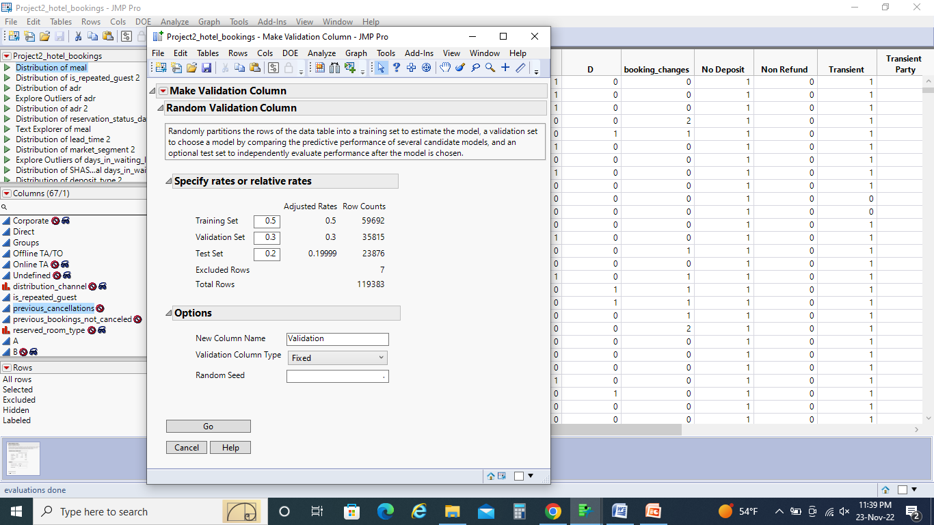
Data PartitionING:
Training = 50%
Validation = 30 %
Test = 20%
Our data set had large no of records, so in order to make my model to perform more accurately ,I used the above mentioned split ratio

Slide 14

Modeling
Models Build in the project :
Logistic Regression
Decision tree
Boosted Tree
Bootstrap tree
Neural network
Discriminant analysis
A KNN Model
Navie Bayes
Model Comparison/Ensemble model

Slide 15
Model Comparison Metrics
Mis Classification rate
- Based on the error of the model we can tell that with how much accuracy we are going to predict the model
Confusion matrix
Based on the Accuracy of the model we figure the best performing model and also determine whether the model is over fitting or not
ROC
Based on the maximum Area under curve
Column Contributions
It can’t be major decision factor for every model but we can at least figure out whether any new variable had more significance with respect to target variable

Slide 16
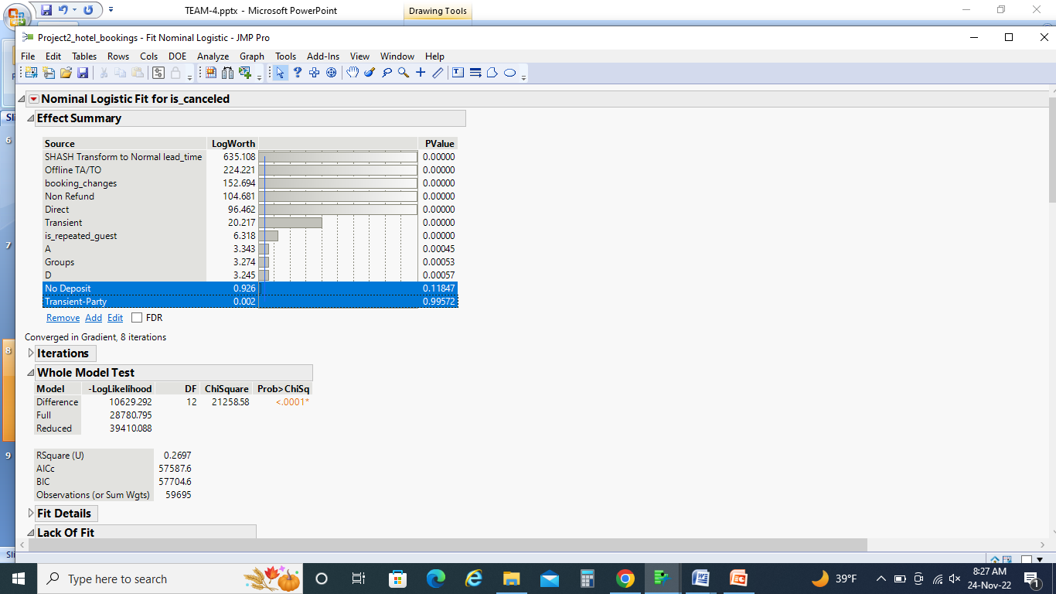
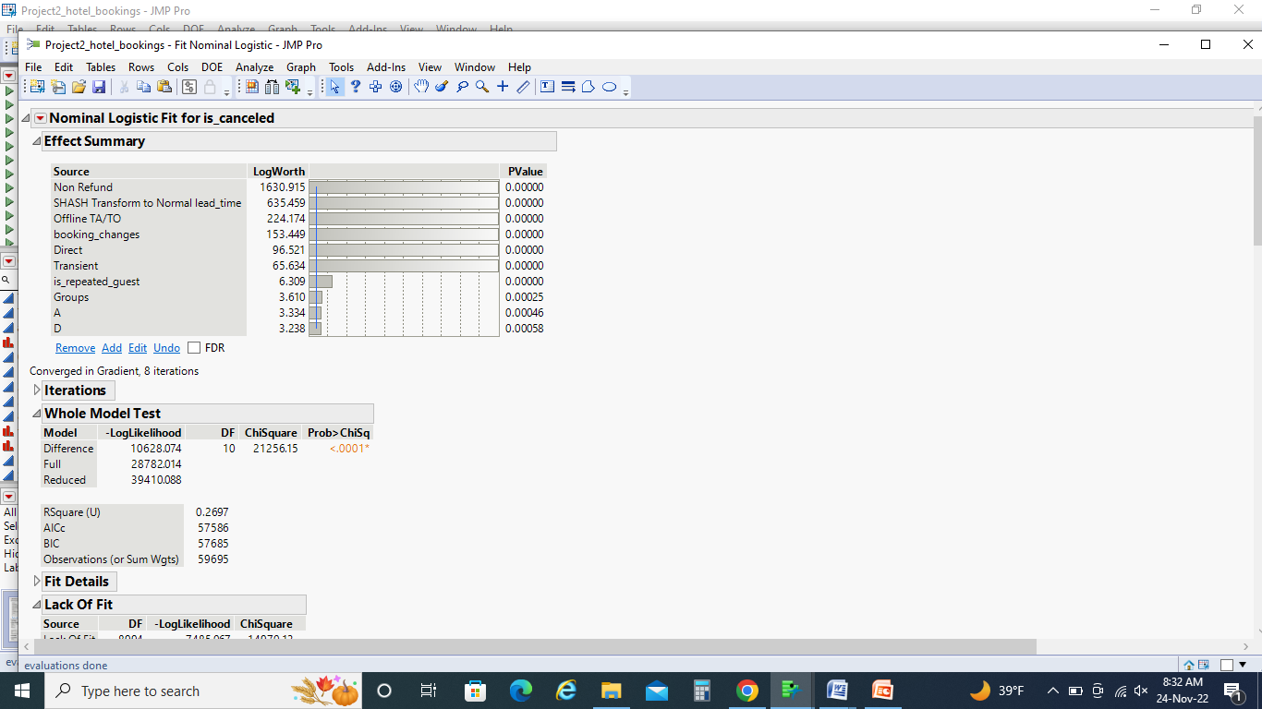
Columns excluded from model after Logistic Regression
Based on the P-Value, the columns which are having p_value greater than 0.05 are excluded from the further model performance
These columns have a statistical significance to predict the target variable. So, we used this columns for all models to predict the

Slide 17
Model Comparison :
KNN model
Decision Tree
logistic
Bootstrap
Model Averaged Ensemble Model
Discriminant model
Boosted
Neural Network
Model Averaging
Navie Bayes

Slide 18
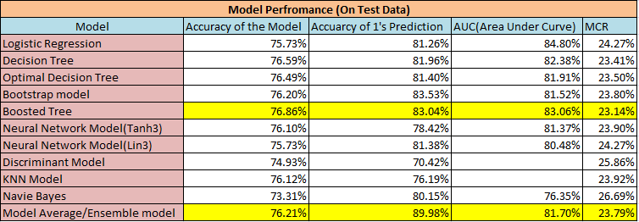
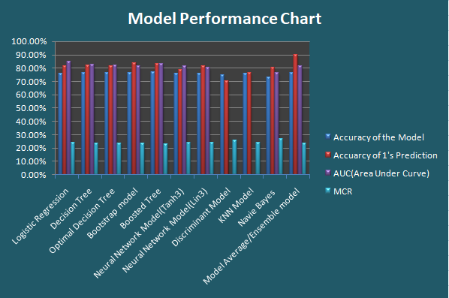
Performance chart:
From the performance chart we figure out that boosted and Model Average ensemble model had almost similar performance but little difference in Accuracy of 1’s prediction

Slide 19
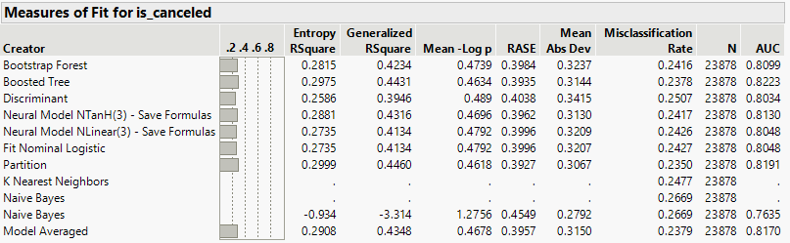
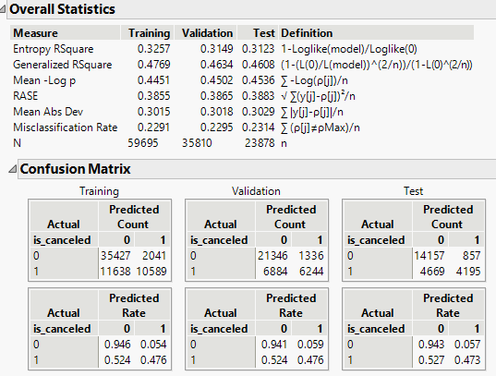
Comparison of Confusion Matrix
Ensemble Model
Based on the comparison of Boosted and Model averaged ensemble model we can confidently say that both model are not overfiiting
Accuracy of the bootstrap model = 76.21 %
Accuracy of the boosted model
76.86%
Accuracy of 1’s prediction
83.04%
Accuracy of 1’s prediction
89.98%
Boosted

Slide 20
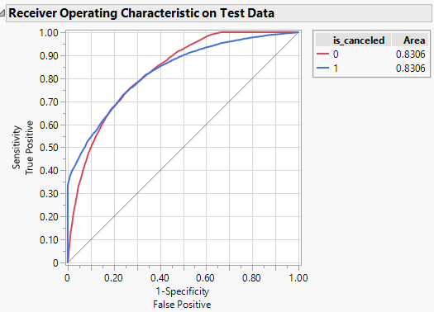
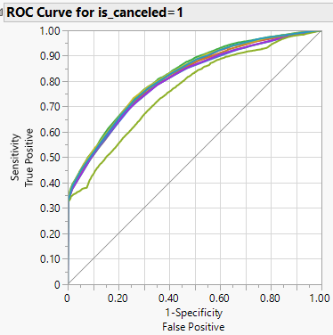
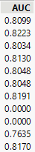
Comparison of Roc CURVE :
Boosted
Boosted
AUC = 83.06%
Model Averaged
AUC = 81.70%
Model Averaged

Slide 21
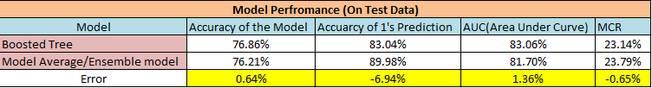
Final Best Model:
When we see the above results it clearly tells that Accuracy , Area under Curve and Miss classification rate outputs are almost in similar to each other.
The Accuracy of 1’s prediction is higher in the model average ensemble model which means it correctly predicting the actual positives more than the Boosted model
Based on the two models Accuracy of 1’s prediction we decided that Model Averaged ensemble model is the best model

Slide 22
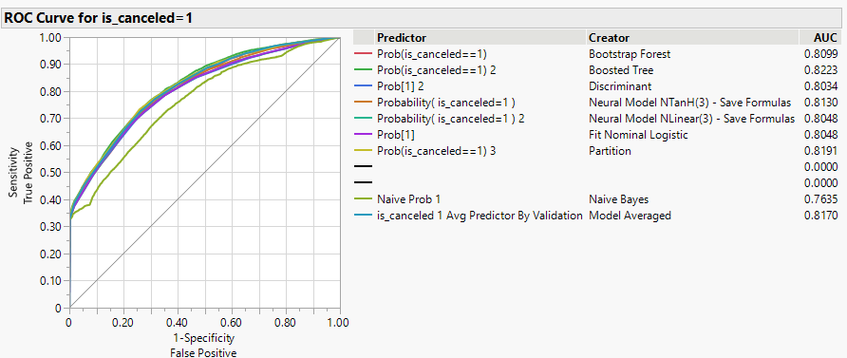
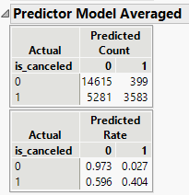
Best Model :- Model Averaged Ensemble Model
Ensemble model i.e. Model Averaged is performed by averaging the predictions of other models like Logistic, Decision tree, bootstrap, Boosted, Discriminant, Neural and Naive Bayes
In this model there is a significance reduction of False Positive rate helps this model to predict 89.98 % correctly stating that bookings are cancelled

Slide 23
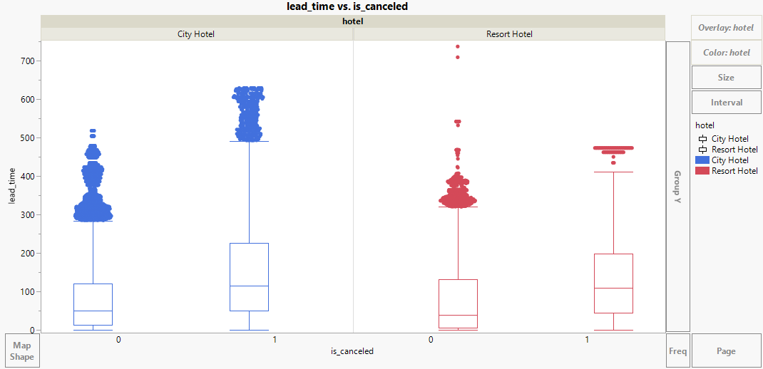
Trends/Patterns w.r.t Business Case :
The boxplot explains the relationship b/w lead_time v/s booking is cancelled or not based on the hotel type
The median value of the booking cancellations of both hotels are higher than the bookings not cancelled
In both hotels , booking cancellations are increased with increase of lead _time arrival of the customer

Slide 24
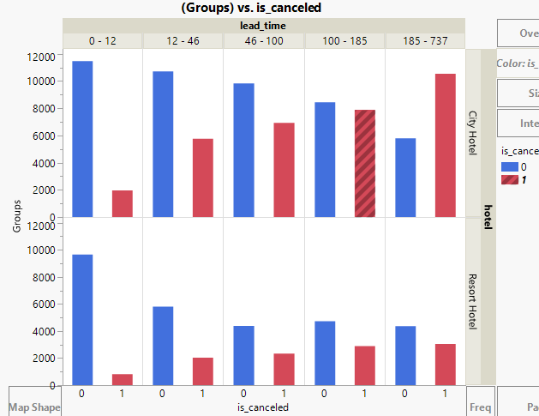
From the Groups in the market segment of Resort hotel we can say that lead_time is not showing much jump with respect to the both cancellations and not cancellations
From the Groups in the market segment of city hotel we can say that lead_time for booking cancelled is inversely proportional to the booking not cancelled
For the city hotel, the groups are more willing to cancel the bookings with increase of lead_time

Slide 25
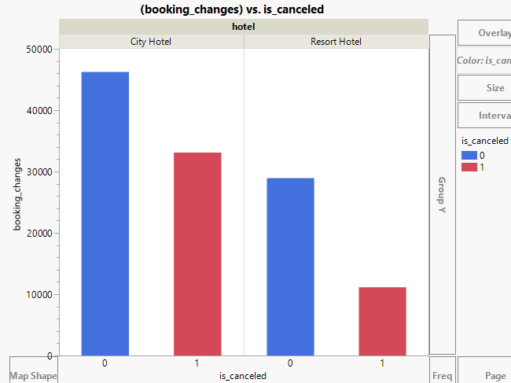
When booking changes at the City hotel, we can say that 75% of the customers are showing interest to cancel the bookings but cancellations at Resort hotel after booking changes is less than the median value of not cancelled
The city hotel is 1.54 times likely to cancel the booking after booking changes compared to the resort hotel.

Slide 26




Recommendation :
Hotels should focus on ‘lead_time’ of the customers where it should not be greater than 80 days in order to reduce the no of booking cancellations.
The hotels should focus more on adding some convenience fee for booking changes initially at the time of hotel booking so that they can have surveillance on the customers and it also helps to estimate the percentage of people who is going to confirm the booking or not.
Bookings that are having no deposit increases the cancellation percentage for both hotels. So, In order to reduce the cancellations, the hotels should make mandatory payment of minimum deposit during the booking for profiles like bookings from other countries, high public profile etc.
It is recommended that the hotel should charge an additional refundable amount of 25% on the bookings made by market segment ‘Groups’ in order to reduce cancellations and increase bookings.

Slide 27
Real-world Adaptability :
This model can be useful for real estate companies to predict the cancellation for different type of hotels and rental apartments.
This model can be used by the analytic industries to predict the cancellation of bookings based on the market segment like booking made by online agents, offline agents, In-person etc.
This model will help the travel websites to keep track on the various type hotels which are more likely to be cancelled and not. Based on the customers interest, the travel websites can update the hotels bookings in the website.
Another way in which this prediction helps us is by providing real time updates about the availability of the rooms and amenities available on a company's website, which further also improves the traffic on the website to attract more customer base.

Slide 28
APPENDIX

Slide 29
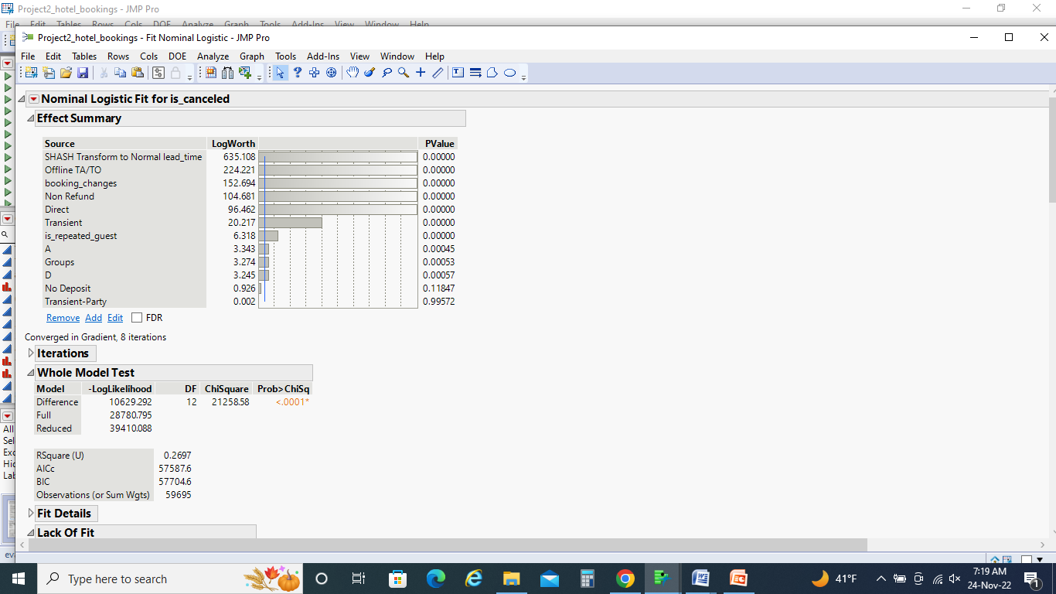
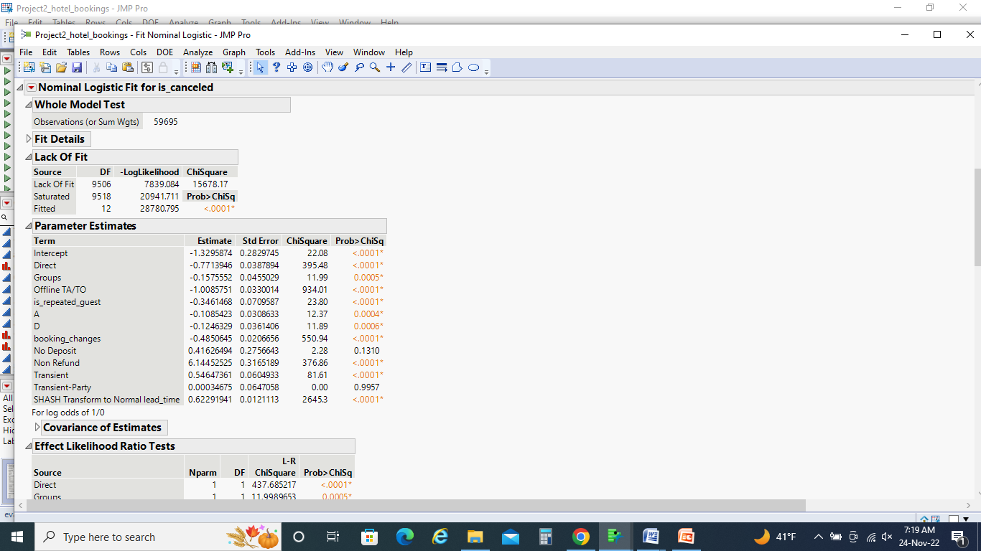
Logistic Regression

Slide 30
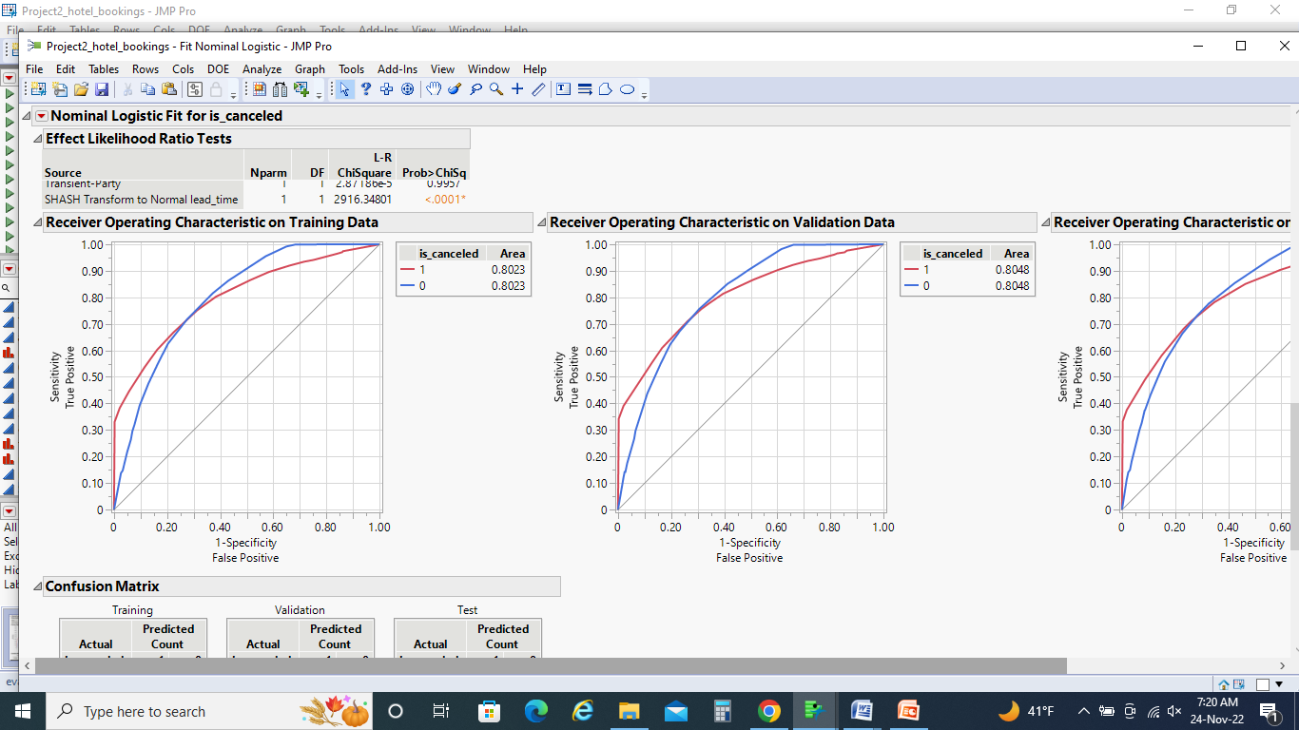
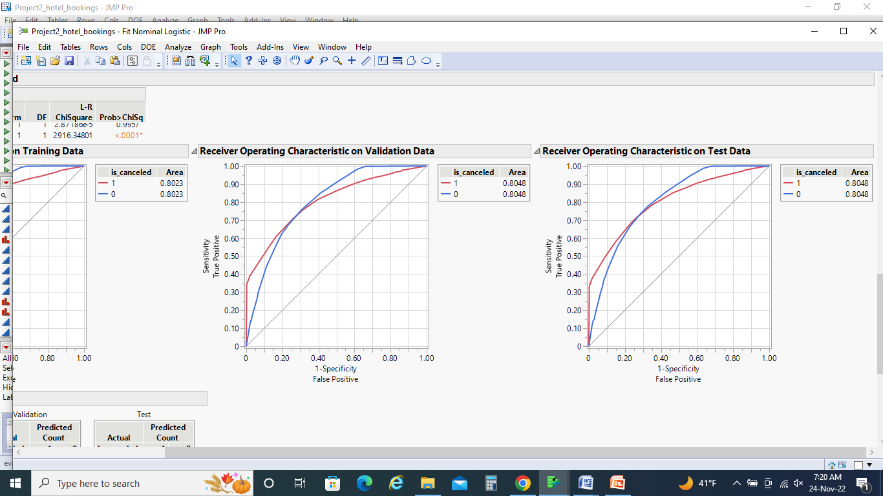

Slide 31
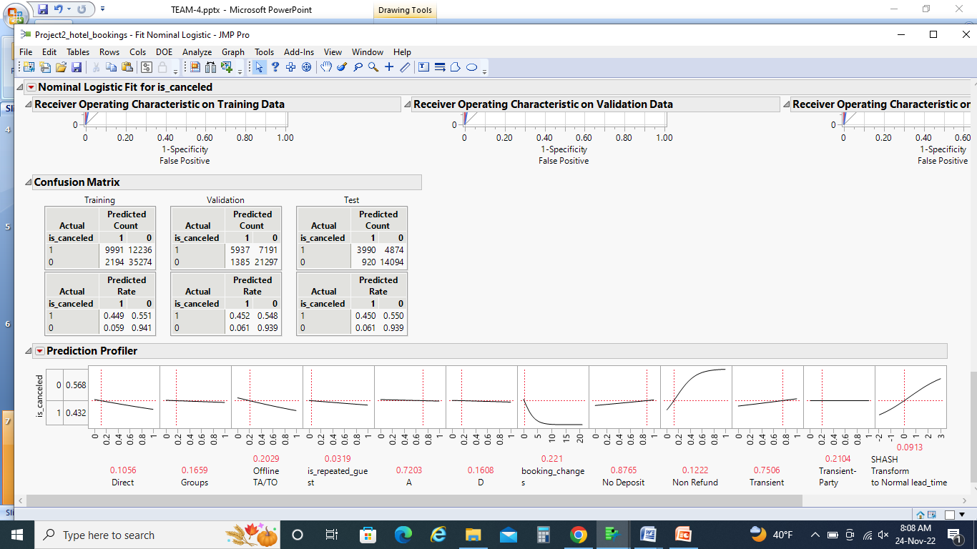

Slide 32
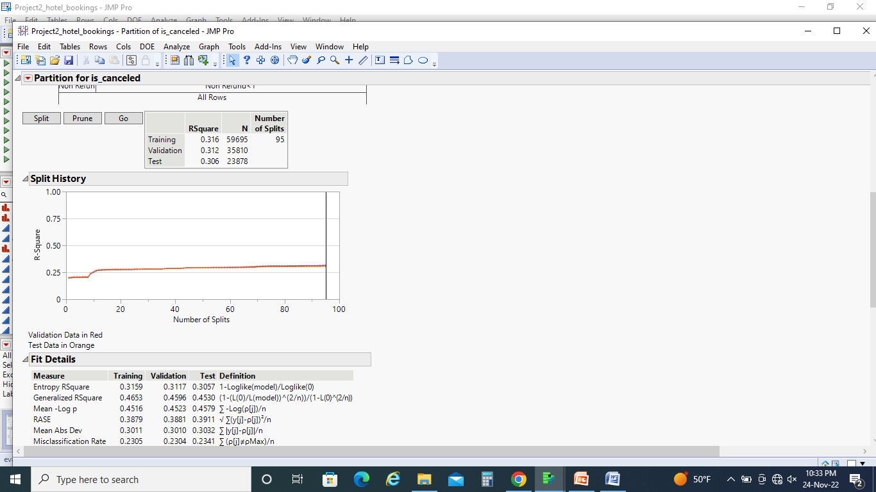
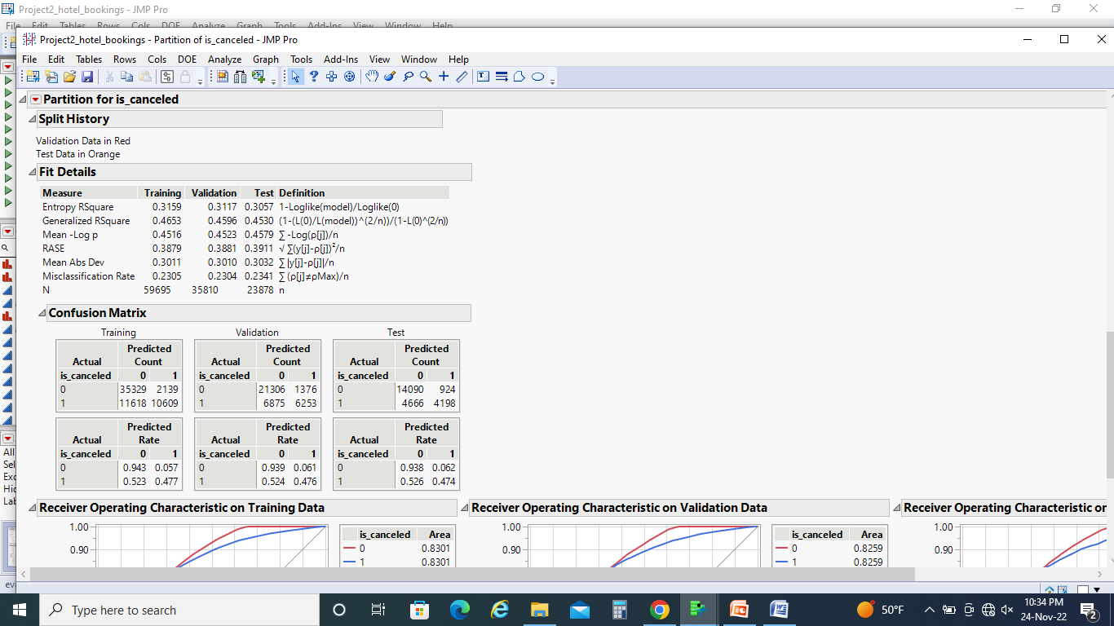
Decision Tree Model:

Slide 33
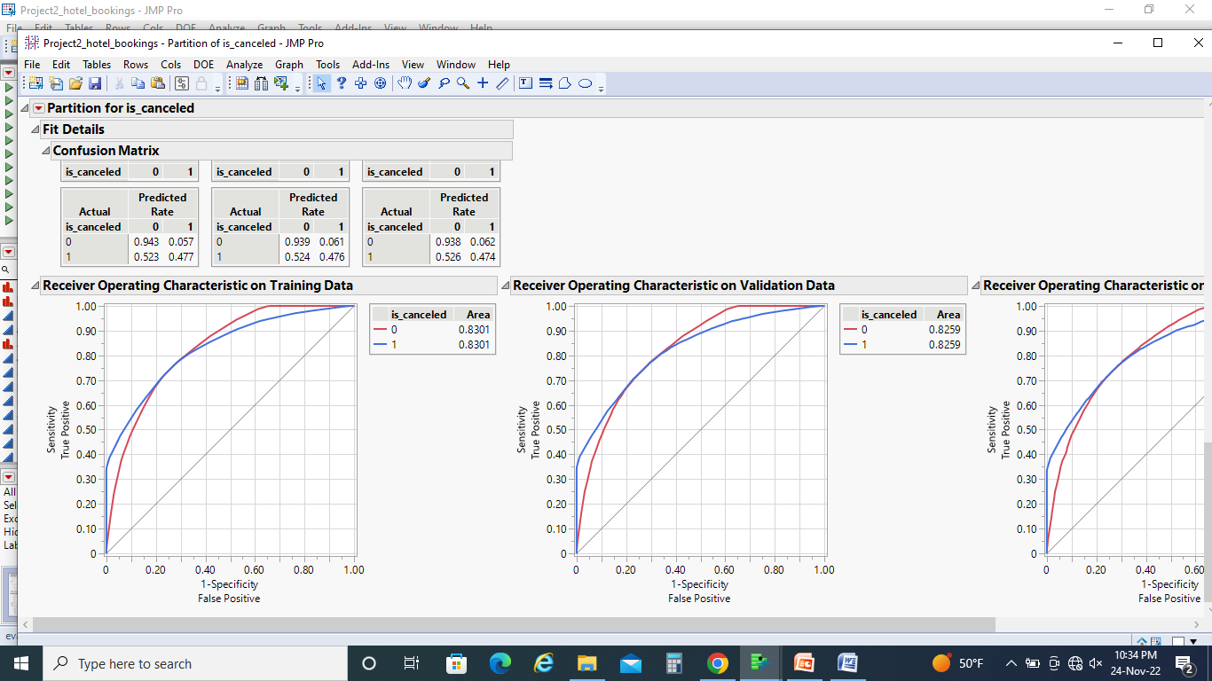
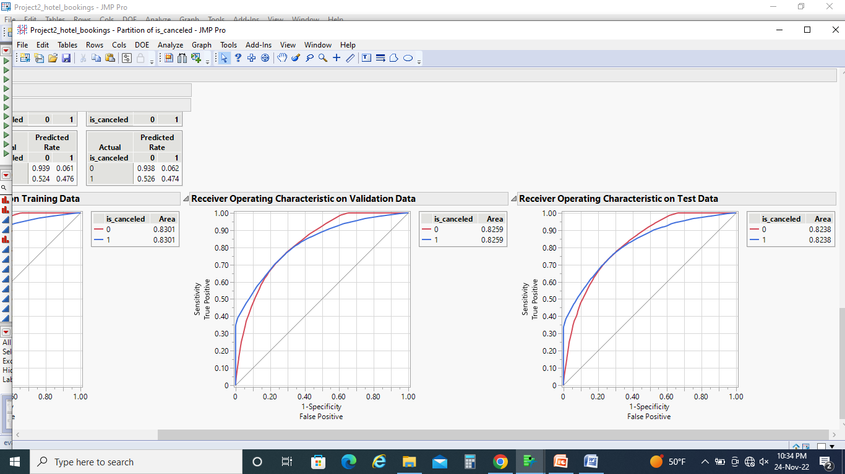
ROC Before Splits:

Slide 34
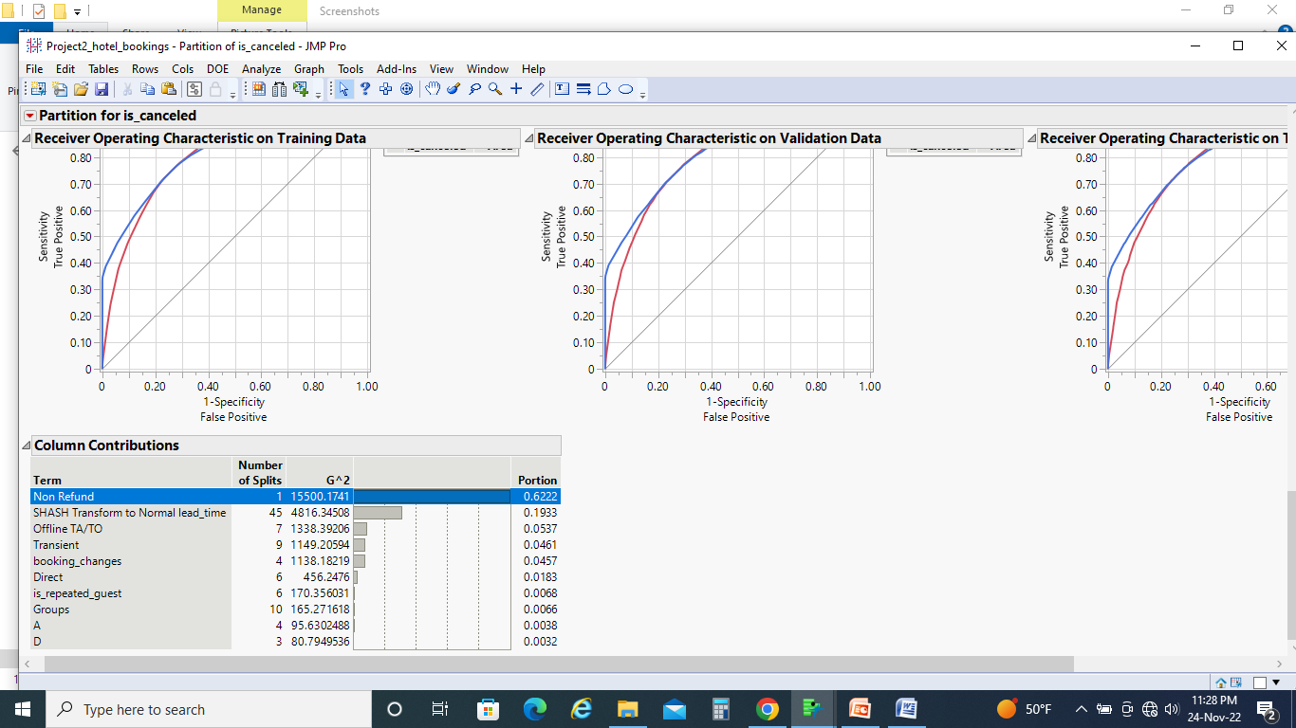
Column Contributions:

Slide 35
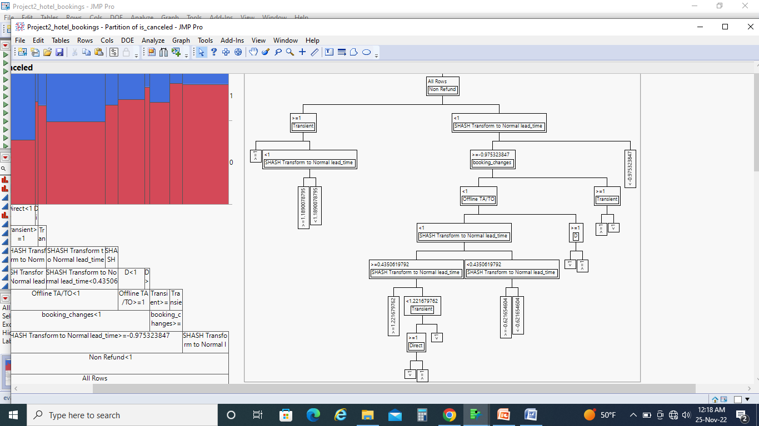
Tree Diagram After splits

Slide 36
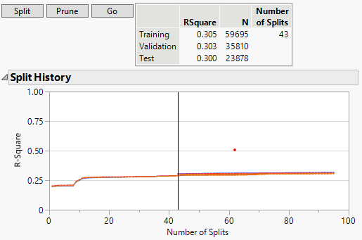
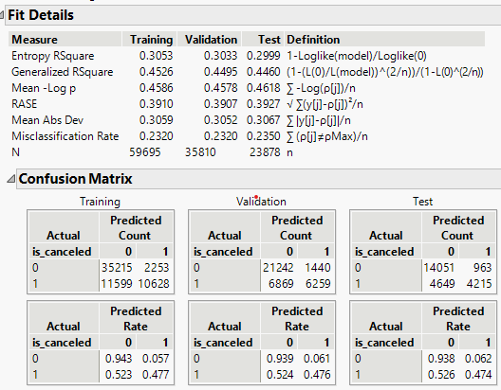
Optimal Splits Analysis(Decision Tree)

Slide 37
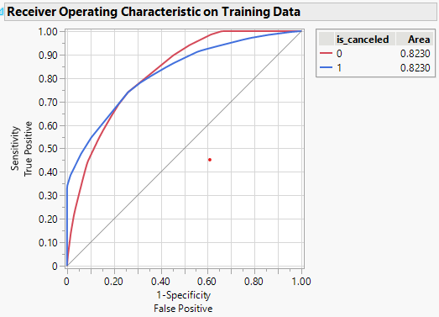
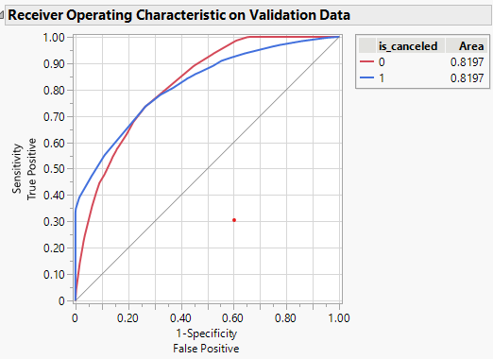
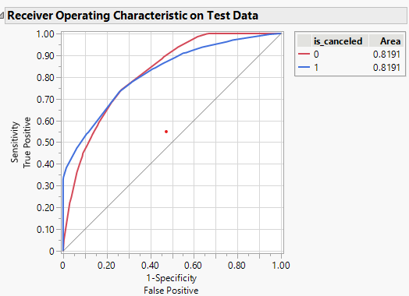

Slide 38
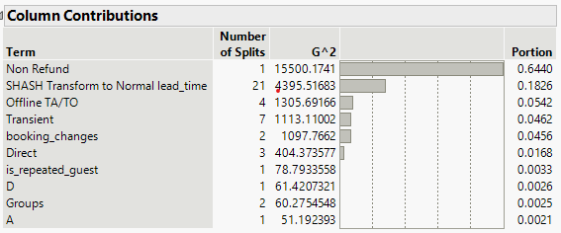

Slide 39
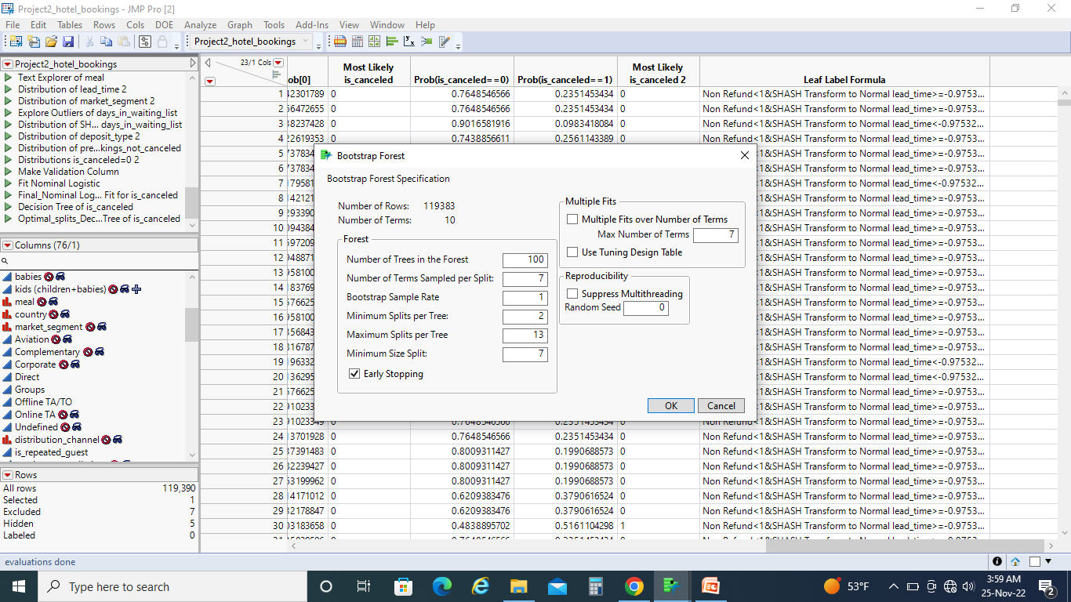
Bootstrap Forest

Slide 40
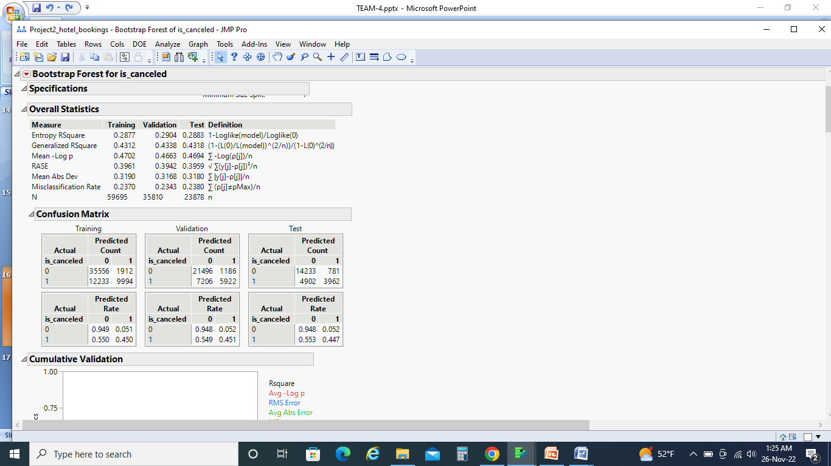

Slide 41
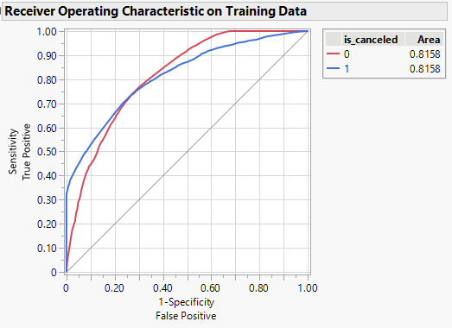
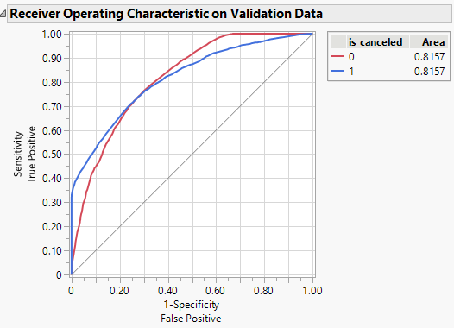
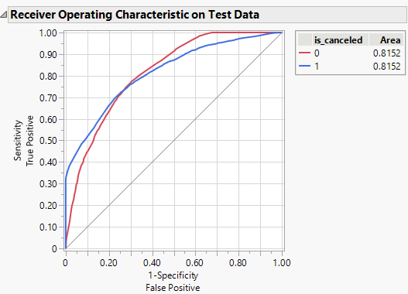

Slide 42
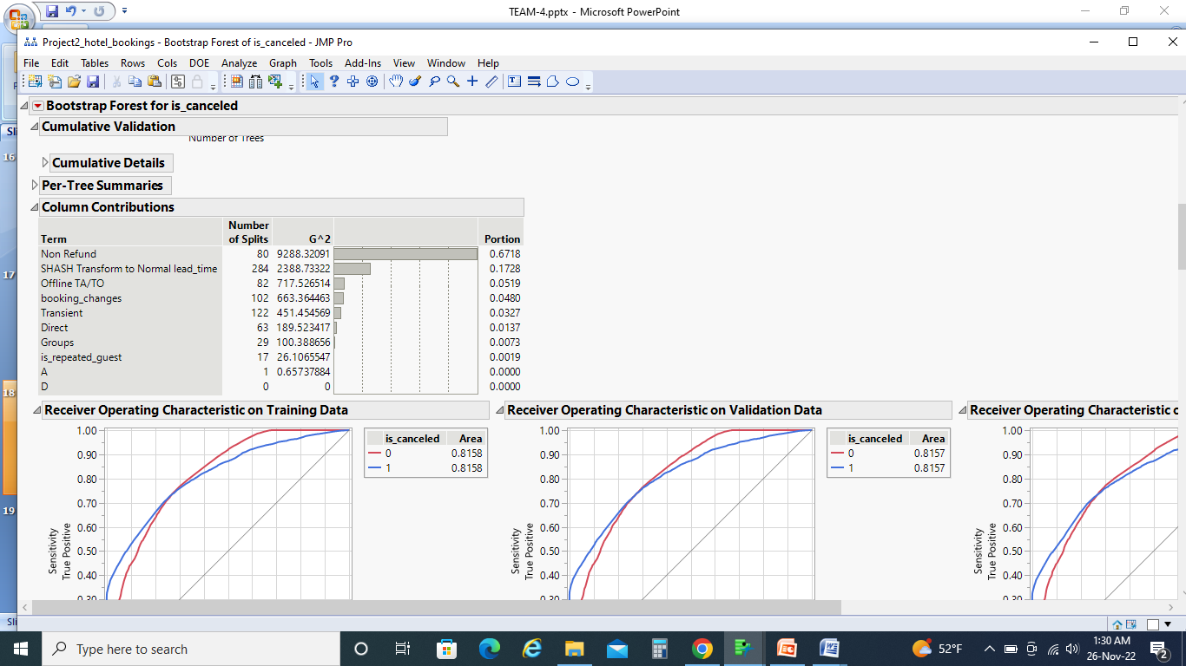

Slide 43

Neural Networks : (Tanh3)

Slide 44


Slide 45




Slide 46


Slide 47



Neural Networks : (Lin3)

Slide 48

Discriminant Analysis

Slide 49

KNN Model :

Slide 50


Slide 51


Navie Bayes :

Slide 52




Slide 53
References :
https://www.kaggle.com/datasets/jessemostipak/hotel-booking-demand?resource=download
DATA MINING FOR BUSINESS ANALYTICS CONCEPTS, TECHNIQUES, AND APPLICATIONS WITH JMP PRO by Galit Shmueli.
https://huskyct.uconn.edu/ultra/courses/_118045_1/cl/outline

Slide 54

Thank you

